Slide 1


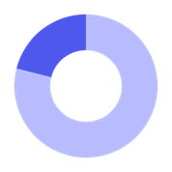





Stormont Vail Health
BEHIND THE ER:
PATIENT CARE IN EMERGENCIES
Indefinitely Approaching Analysis
Laiba Ashfaq, Greyson Henry, Grace Nguyen, Julianna Sparacio, Makena Wyngaard
DataFest 2026

Slide 2

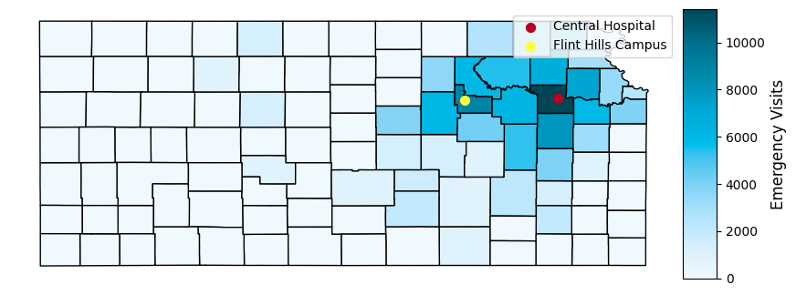
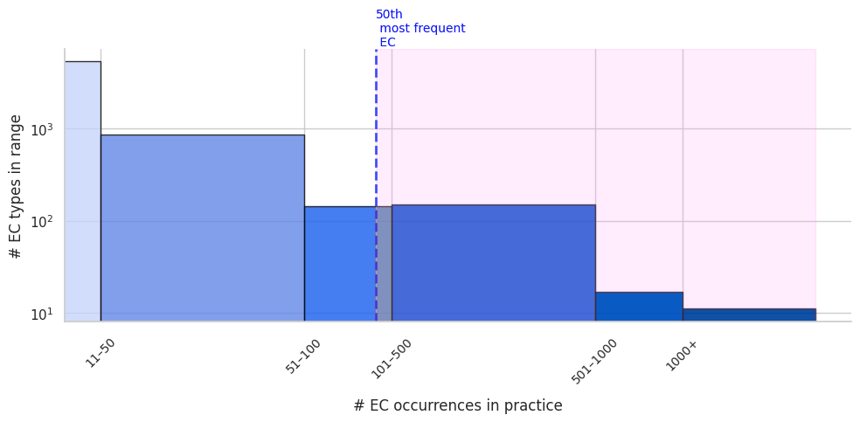
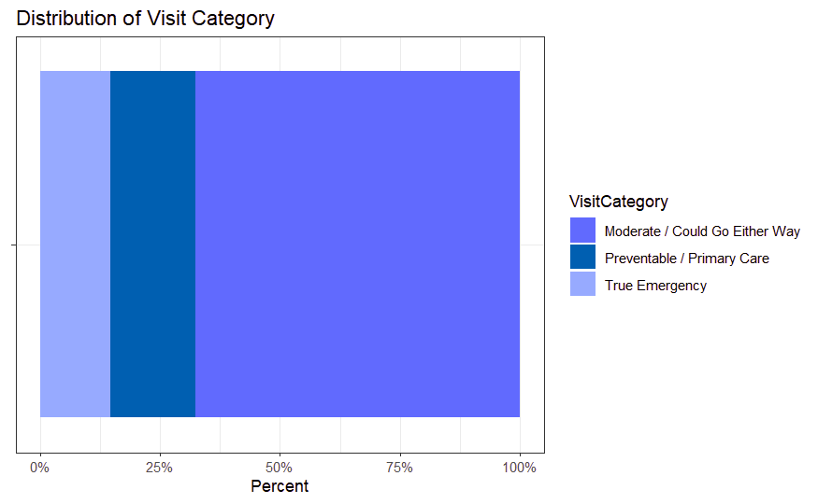
The Patient Journey: Emergencies
Emergency admissions received by Stormont Vail (by county)
EC: Emergency Conditions (reason for visit)
OBJECTIVES
  Explore emergency patient journeys through Stormont Vail
  Analyze unexpected or non-obvious trends among emergency patients
  Consider ways to save time and beds for Stormont Vail’s two emergency centers
Category motivation: Good Samaritan Hospital, San Jose, CA
EC Distribution
The 50 most frequent ECs account for >37% of all ECs
EC frequency
by category
14%
18%
68%
note: to reduce processing time, we investigated a random sample of 3 million of the >7 million encounters provided in the dataset.
Notes:
An emergency is the most stressful experience a patient can have. It’s crucial that Stormont Vail is ready to handle them as smoothly as possible. We’ll look at this in terms of “EC”s (emergency conditions).
CATEGORIZATION
Based on:
VisitCategory urgency metric
Good Samaritan Hospital San Jose’s observations
Abstracted into “preventable”, “necessary”, and “moderate” visits
*NOTE the source just informed our categorization of the top 40 ECs, we used our data not theirs

Slide 3

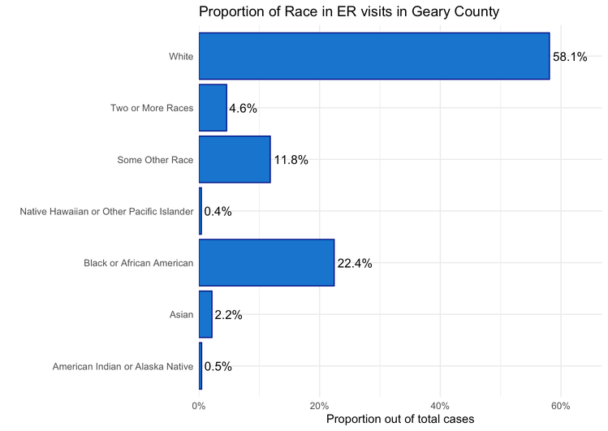
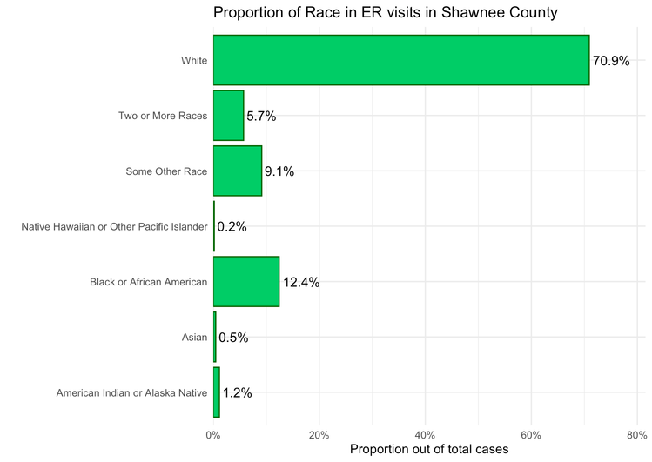
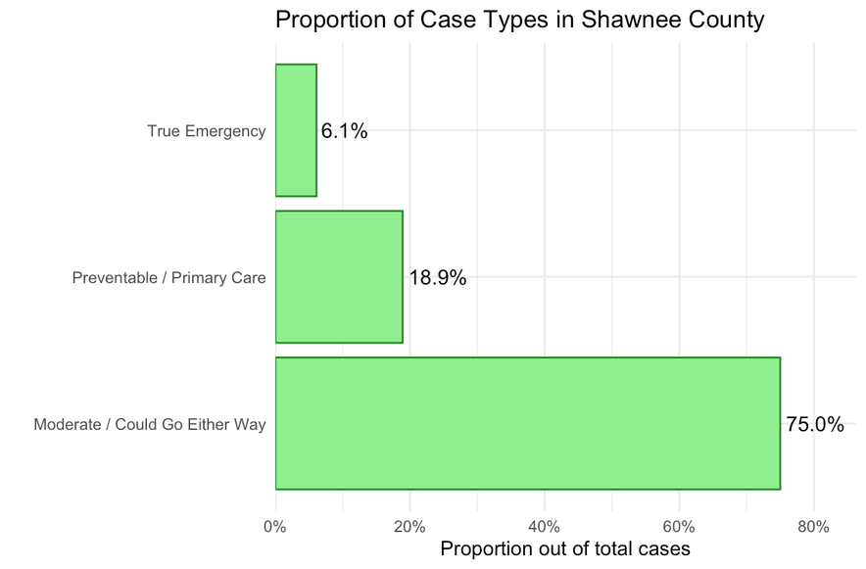

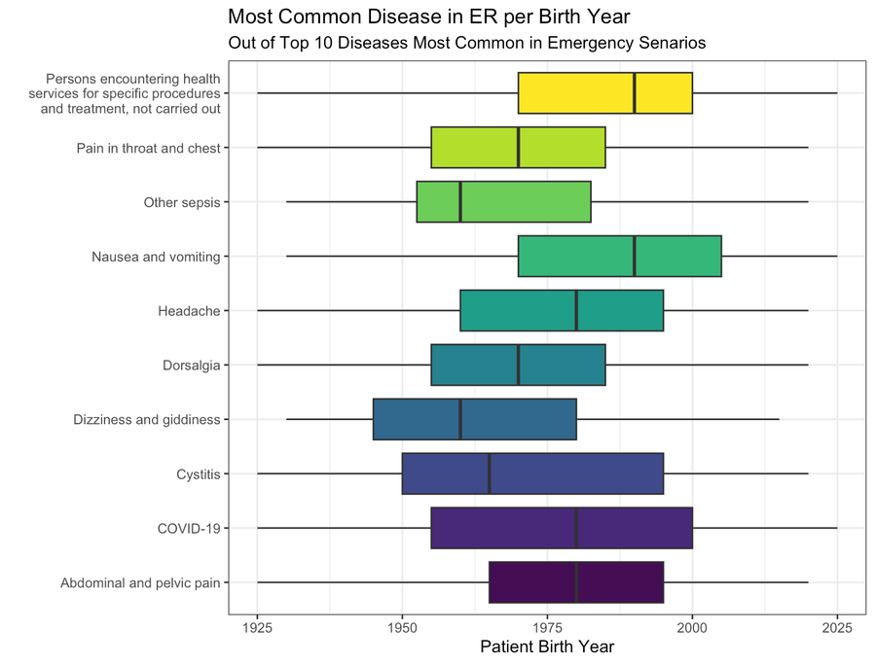
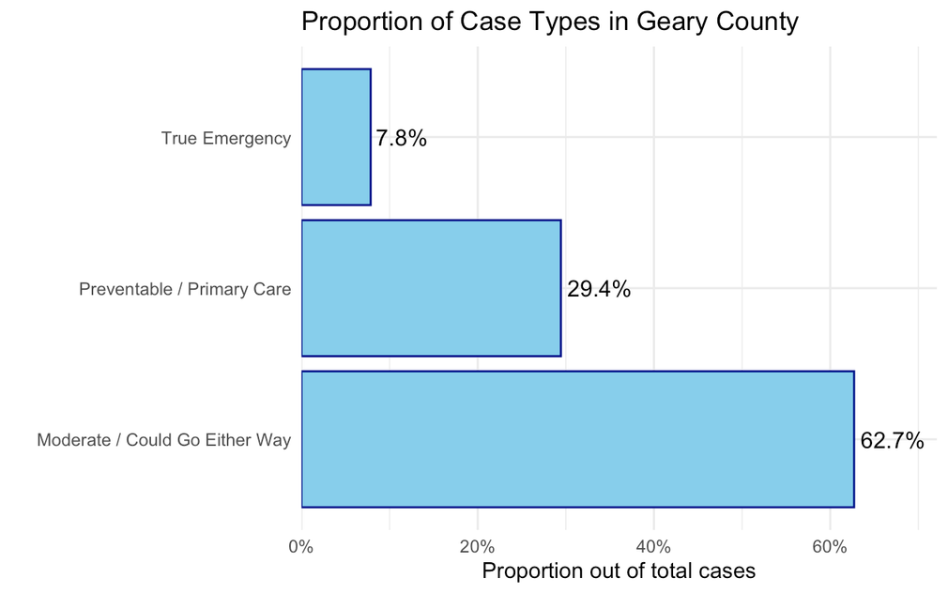
EC Trends by Emergency Center
Geary
Shawnee
Demographics
  Statistical Tests: X2, Moods Median test, ANOVA, Tukey post-hoc
  Outcomes: Mean age across different diseases (specialize?); Geary has higher proportion of POC and Preventable cases (insurance?)
Notes:
DEMOGRAPHICS
based on our table we see that Geary deals with a signficantly higher amount of Non-White patients
Shawnee deals with slightly older patients, but t test
Could patients with preventable cases go to the ER because no insurace to cover PC?
our various chisq tests:
age - began with chi squared tests to see what could be associated with disease, and we found that marital status and birth year were the most significant other factors.
MOODS MEDIAN WAS STATISTICALLY DISCERNIBLE WITH A P VALUE <0.001 small effect size

Slide 4

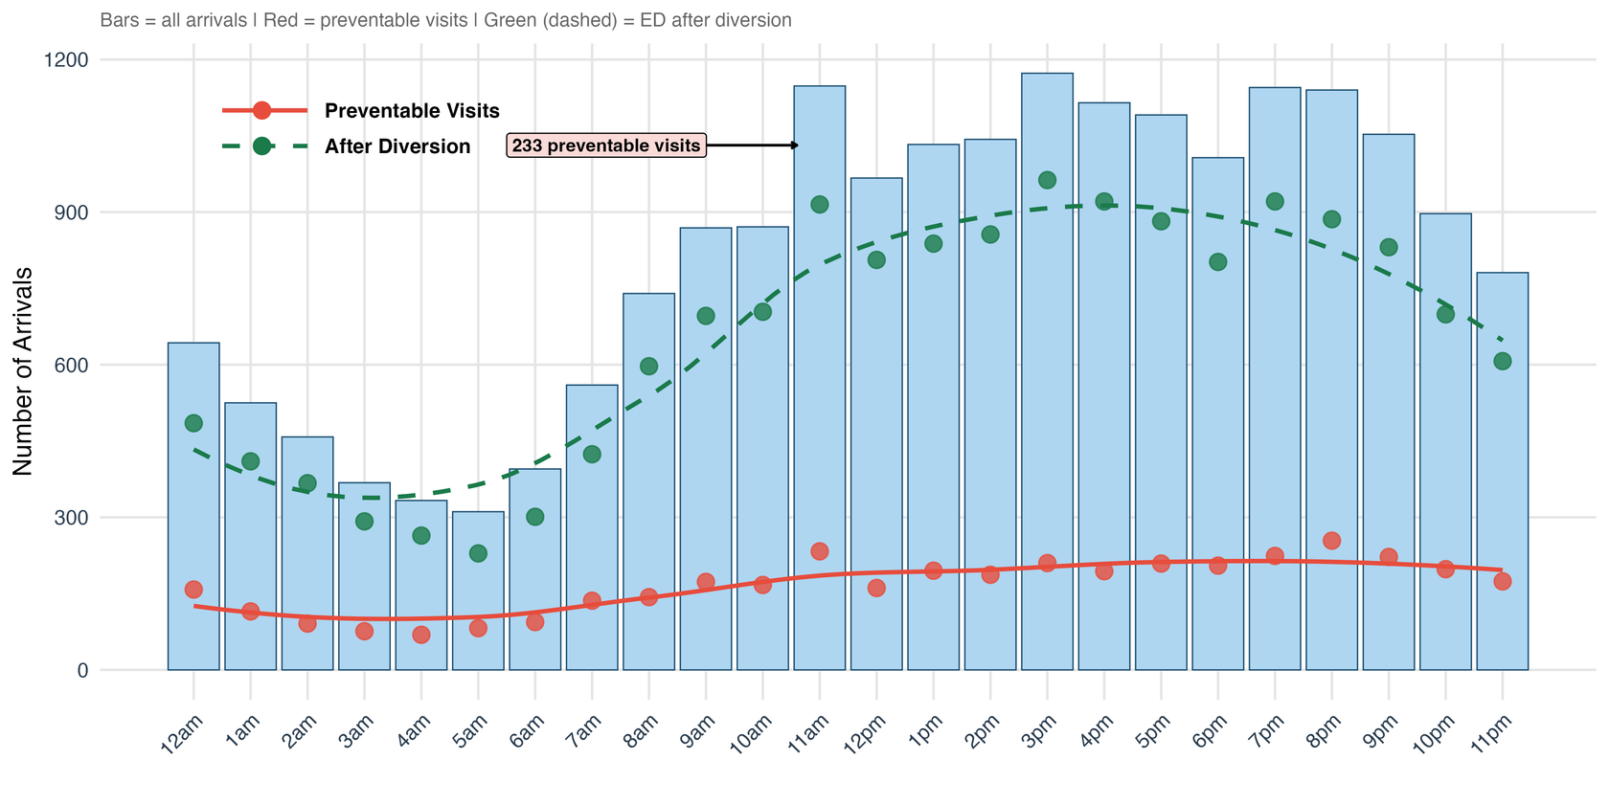
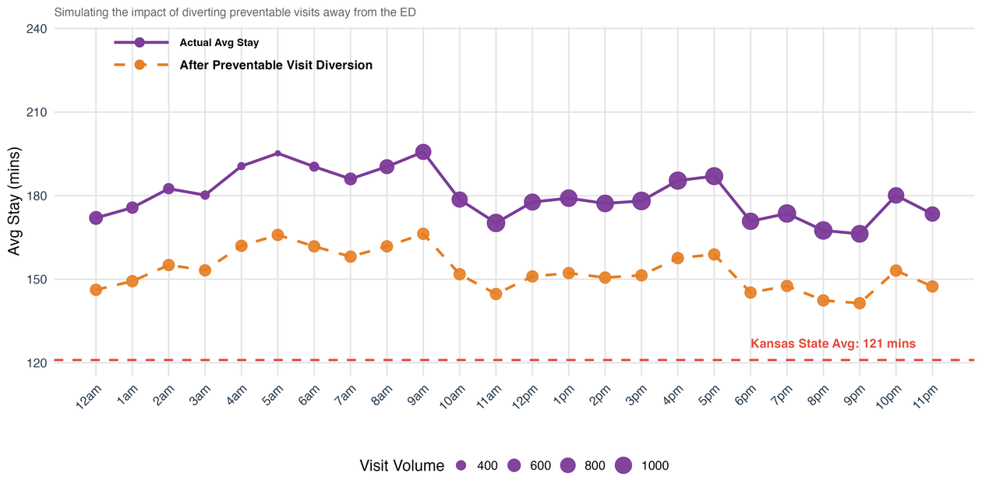
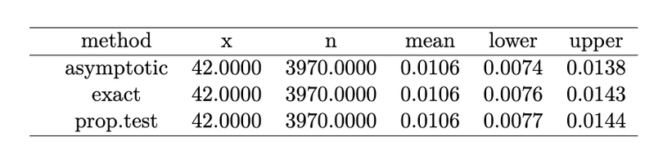
Getting Care Where It’s Most Needed
Hour of Day vs. Arrivals
In the ER and trauma center, time and beds are precious.
Stormont Vail EC wait times exceed the Kansas state average.
​Diverting preventable visits alone could bring the average down to approximately 151 minutes, closing nearly half the gap.
How Close Can Stormont Vail Get to the Kansas Benchmark?
RECOMMENDATIONS
What about complications?
  Redirect today’s patients
  Educate tomorrow’s patients
Notes:
complications - Z-test: mortality rate among preventable visits = 1.05% (p-value not significant — low-risk profile confirmed)
recs!
specialize by age demo -
geary has a lower mean patient age: probably see many younger people who don't have insurance --> perhaps they could provide something like subsidized primary care
LIMITATIONS
What about comorbidities? A comorbidity is when a patient presents with 2+ conditions at once. Our categories and analysis do not account for comorbidities. Two symptoms appearing together can be more “necessary” than the sum of their parts.

